Slide 1
Northeast Roundtable
March 4, 2020

Slide 2
Notes:
Welcome
Territorial acknowledgment
Roundtable introduction
Acknowledge 10th meeting, thank everyone for their time, give each other a round of applause for our work
Review agenda – any additions or changes
January 22, 2020 Roundtable meeting minute endorsement
- Action item update

Slide 3
Roundtable Code of Conduct
Mutual respect
Accountability / scope management
Transparency
Ask questions
Listening is as important as talking
Sharing and openness
Preparedness
Notes:
- For new members; do we have any new members today?

Slide 4
https://nestakeholderroundtable.ca/
Notes:
Reminder that everything will be posted online
Pause here, before we get into discuss on Regional Initiatives, I would like to take a moment for us to get to know each other a bit better.
I ask that you stand up and approach someone you haven’t met yet, or perhaps don’t know as well:
Introduce yourself, ask your partner: who do they represent at the Roundtable, what their interests are here at the Roundtbale, where are they from, and their favourite thing they like to do outside of work?

Slide 5
Intergovernmental Partnership Agreement Conservation of Southern Mountain Caribou - Central Group & Section 11 Agreement

Slide 6
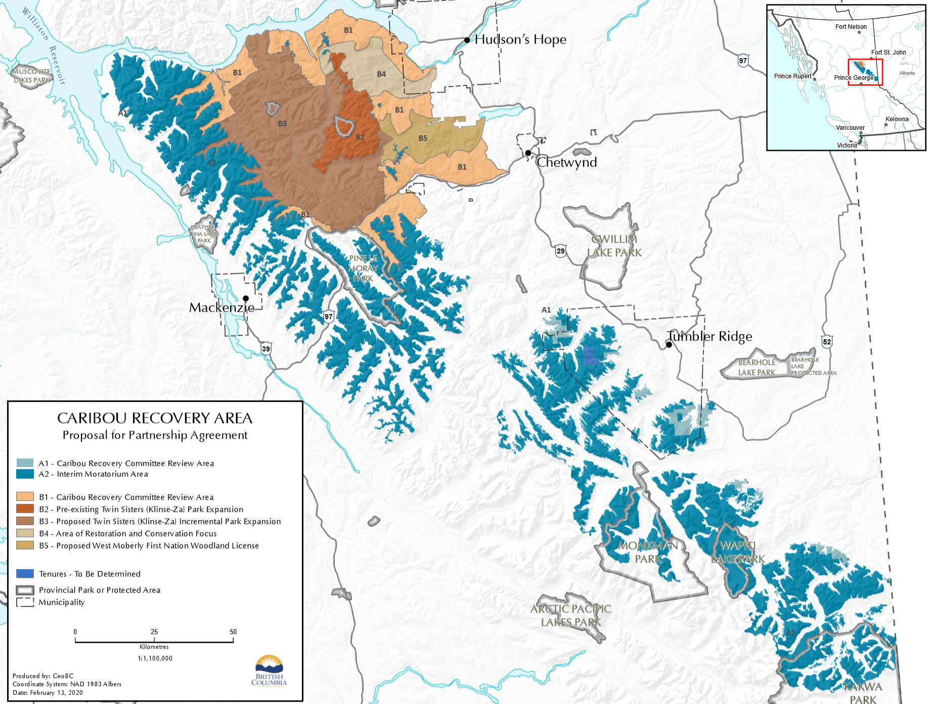
Partnership Agreement Overview
Partnership Agreement applies to Central Group.
Moratorium in A2 and B3 zones
Reconfirms commitment to the Klinse-za park B2
New Land Use Objectives
Caribou Recovery Committee
Winter Recreation review
Notes:
Partnership agreement applies to Central Group.
Specific action in the Central group.
Moratorium in A2 and B3 zones. Interim moratorium on new applications but agreement commits to making these areas permanent or at a minimum renewing as interim
Reconfirms commitment to the Klinse-za park B2 I would tell them that the B2 Park has been approved for the base (next page map)
New Land Use Objectives Committee in place to work through the provincial rep on the TWG
Caribou Recovery Committee Reviews new applications in the A1, B1 and B4 zones new language in the agreement that confirms Local governments will be engaged if the application warrants this.
Snowmobile Advisory Committee – includes reps from S. Peace clubs, local governments, WMFN, SFN, Canada and BC

Slide 7
Partnership Agreement Continued…
Federal funding for Tenure Compensation and Community Transition
3 technical committees have been formed to address concerns raised by communities, and support the Partnership Agreement implementation:
Socio-economic Subcommittee
Caribou Land Use Objectives Subcommittee
Snowmobile Advisory Committee

Slide 8
Improving Community Relations and Reconciliation
West Moberly First Nation & Saulteau First Nation
Additional language that will support involvement of local governments and improved community relations:
Added text to provide greater clarity on how B.C. will include local governments in caribou recovery planning and how local governments will be consulted on the work of the Caribou Recovery Committee.
Commitment to work with local snowmobile clubs in the development of a snowmobile management plan.
Commitments to address the racism that arose during the public engagement on the Partnership Agreement.

Slide 9
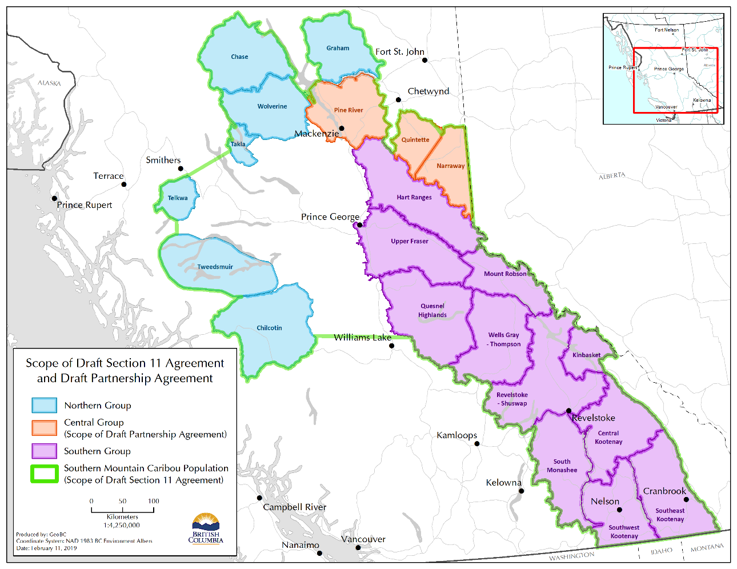
Section 11 Agreement Overview
Southern Mountain Caribou
Framework document on how the Federal and Provincial Governments will work together
Aligns B.C.’s Caribou Recovery Program Plan with Federal objectives/expectations
Primary tool is Herd Planning
Notes:
Scope: Southern Mountain Caribou Federal Recovery Strategy Area (green boundary on map)
Parties: Environment Climate Change Canada and B.C.
Benefits:
Aligns B.C.’s Caribou Recovery Program Plan with Federal objectives and expectations.
Positive, collaborative approach to Caribou Recovery.
Could reduce potential for a federal Section 80 SARA Protection Order.
Access federal funding.
Demonstrates a strong stance on species at risk recovery and reconciliation.
Potential Impacts: Agreement does not include prescribed protected areas. Development of herd plans through collaborative process with First Nations and stakeholders.

Slide 11
Questions?

Slide 12
Provincial Assessment 1997 Fort St John Land and Resource Management Plan

Slide 13
Purpose (1997):
“Maintain resource development opportunities to sustain the economic base of the planning area communities while maintaining high outdoor recreation, wilderness, wildlife and biodiversity for future generations.”
1997 LRMP Planning Table

Slide 14
Structure (1997)
Planning table consisting of representatives from:
Provincial natural resource ministries
Local government
Energy sector
Agricultural/ranching sector
Forestry sector
Guide outfitters
Recreation groups
Conservation groups
Consensus-based decision making
Large public participation component

Slide 15
Planning Boundary (1997)
Fort St John Timber Supply Area served as the planning boundary
Includes communities of:
Halfway River First Nations
Blueberry River First Nation
Doig River First Nation
Fort St John
Taylor

Slide 16
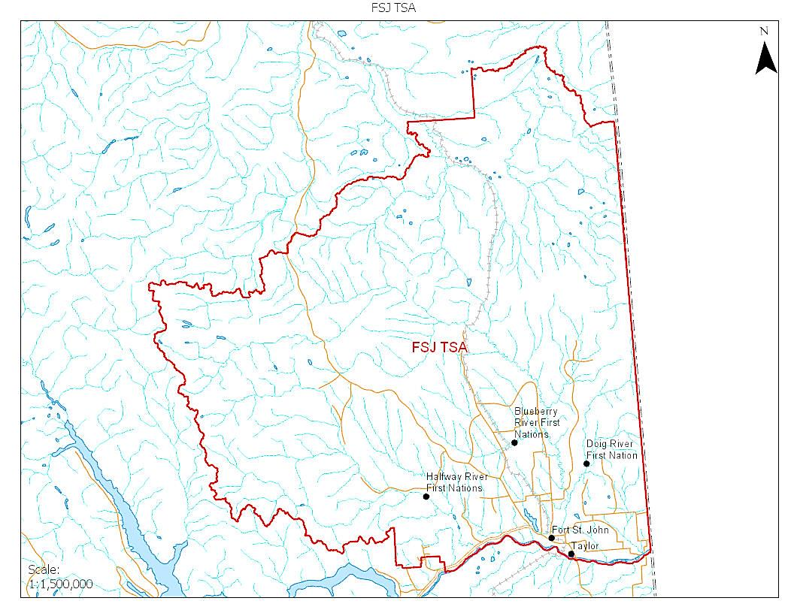

Slide 17
Resource Management Zones (1997):
Landscape divided into 27 Resource Management Zones (RMZs) containing site-specific management direction ecological and socioeconomic values
RMZs delineated using combinations of
Administrative boundaries
Ecological boundaries
Tenure boundaries

Slide 18
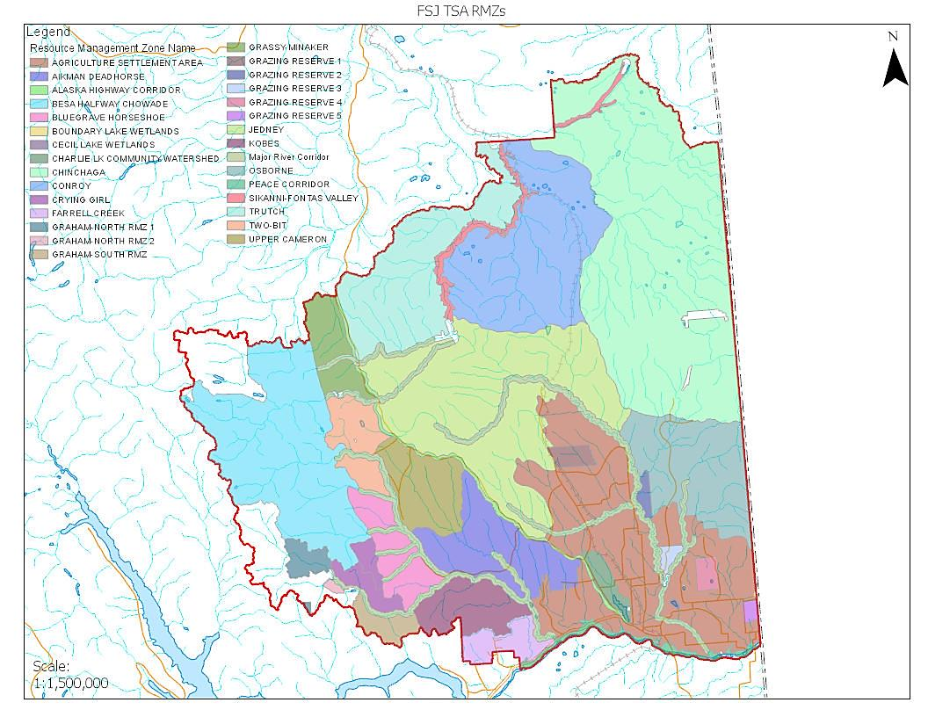

Slide 19
Provincial Land Use Categories (1997)
RMZs combined to form 5 broad provincial land use categories that established a overarching management regime for an area
Agriculture/settlement (12%)
Enhanced resource development (20%)
General resource management (46%)
Special management (18%)
Protected areas (4%)

Slide 20
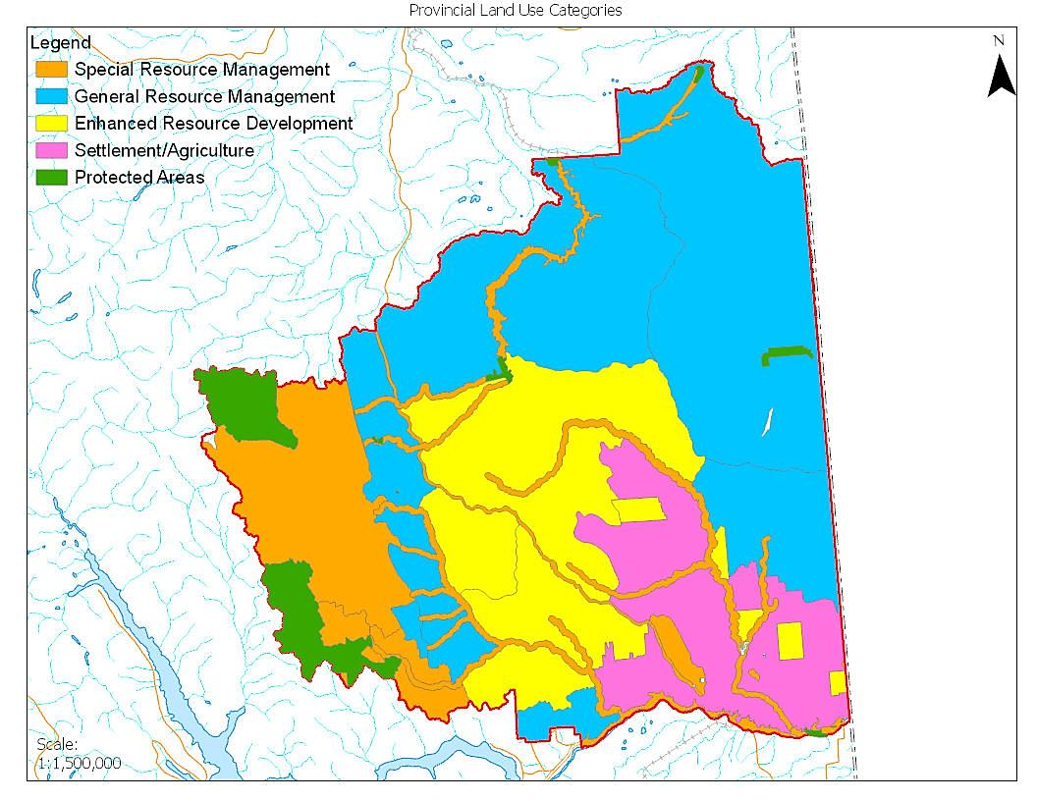

Slide 21
Values (1997)
Agriculture
Range
Forest Management
Energy
Recreation & Tourism
Access
Fish & Wildlife
Biodiversity
Culture & Heritage
Minerals
Water
Visual Quality
Air Quality
Trapping
Guide Outfitting
Communication Transportation & Utilities
Protected Areas

Slide 22
Management Direction (1997)
Wildlife Example:
General Management Direction: Ensure habitat needs are met for rare, endangered, and regionally significant wildlife species
Management Objective: Maintain medium-high quality grizzly bear habitat in the Major River Corridors RMZ
Management Strategy: Incorporate habitat protection criteria for grizzly bears into landscape and stand level plans
G
General Management Direction
Management Objectives
Management Strategies

Slide 23
Implementation Highlights

Slide 24
Muskwa-Kechika Management Area (1997)
Designated December 11th 1997 under Order In Council:
“..the management intent for the Muskwa-Kechika Management Area is to maintain in perpetuity the wilderness quality, and the diversity and abundance of wildlife and the ecosystems on which it depends while allowing resource development and use in parts of the Muskwa-Kechika Management Area designated for those purposes.”
Muskwa-Kechika Management Area Act

Slide 25
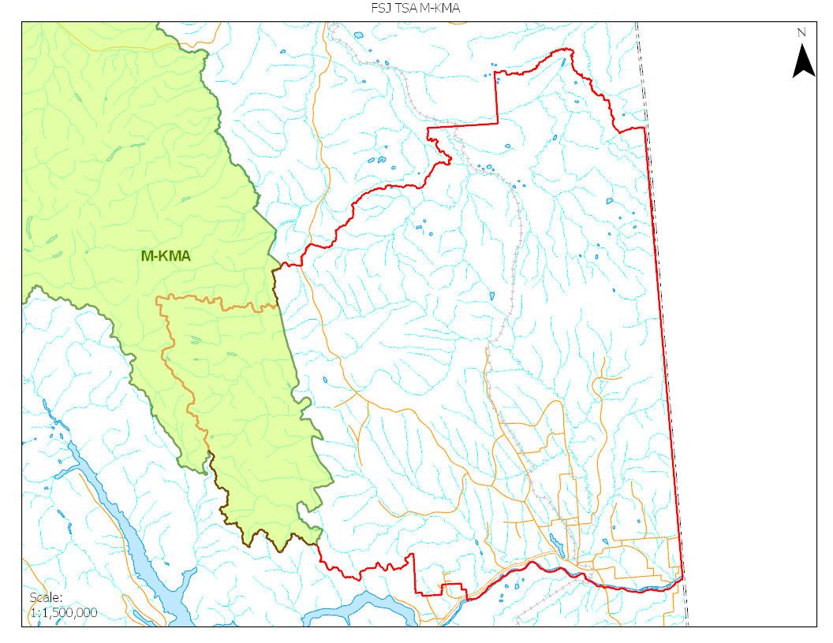

Slide 26
Protected Areas (1997)
LRMP resulted in 9 new protected areas being created
4% of the FSJ TSA
200,000 hectares
Goal 1 Protected Areas established for representation included:
Milligan Hills
Graham-Laurier
Redfern-Keily
Goal 2 Protected Areas established for special features include:
Sikanni Chief Canyon
Sikanni Chief Falls
Pink Mountain
Sikanni-Old Growth
Ekwan Lakes
Peace River Corridor

Slide 27
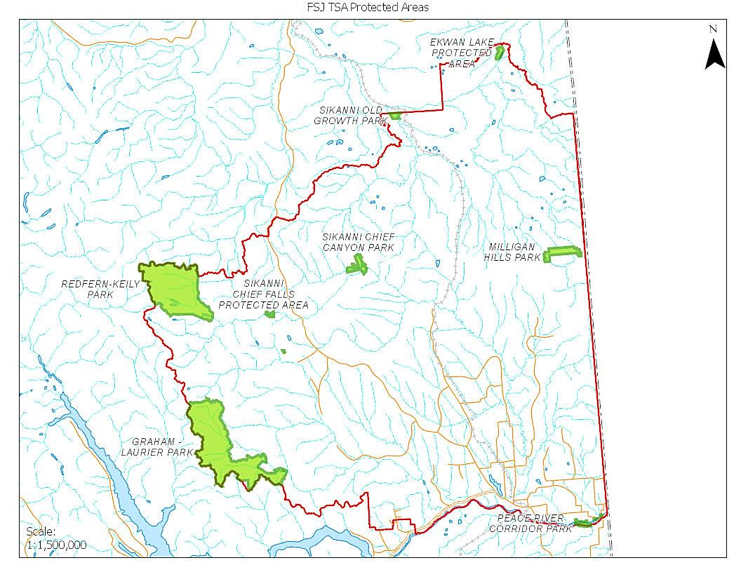

Slide 28
Sustainable Forest Management Plan
Overarching forest stewardship plan that serves as legal mechanism for implementation of LRMP objectives
Objectives translated into operational guidance through public advisory group (PAG)
Targets
Indicators
Encourages lower level planning and implementation monitoring
River Corridors
RMZ example:

Slide 29
Lower-level Planning
Many of the 1997 LRMP objectives required landscape level planning for implementation
Post 1997 implementation is consistent with LRMP objectives
Lower-level planning examples include:
Wildlife Habitat Areas
Ungulate Winter Ranges
Land Act Reserves
Recovery planning for species at risk
Priority watersheds
Access management (M-KMA)
Water quality monitoring sites
Cumulative Effects Framework
Regional Strategic Environmental Assessment

Slide 30
1997 LRMP in Decision Making
SFMP guides forestry operations and associated authorizations - Ministry of Forests, Lands and Natural Resource Operations (FLNRORD)
RMZs included in status tool for land and water authorizations -FLNRORD
Management direction considered in subsurface authorizations - Ministry of Energy, Mines and Petroleum Resources
Management direction considered during review pipeline proposals (Federal)
Some management direction considered in surface authorizations – Oil and Gas Commission
Park use permits required that are consistent with management plans – Ministry of Environment and Climate Change Strategy

Slide 31
Implementation Gaps

Slide 32
Muskwa-Kechika Management Area (1997)
1997 LRMP called for the establishment of general forest production targets for landscape units within Besa-Halfway-Chowade and Graham North RMZs
SFMP Translation: Landscape unit objectives need to be set prior to the approval of timber harvesting in the M-KMA
To date, no landscape unit objectives have been established for timber harvesting in the M-KMA

Slide 33
Protected Areas
Proposed protected areas that are yet to be established include:
Beatton-Doig Canyon
Chinchaga Lake

Slide 34
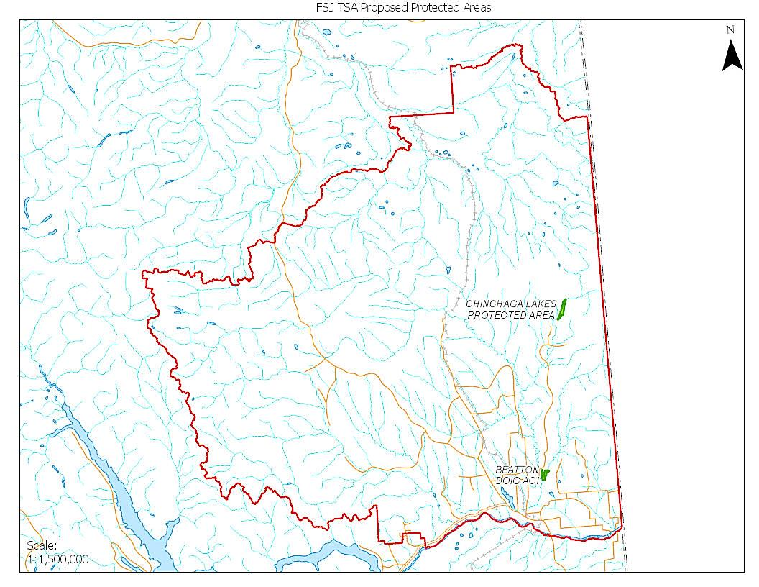

Slide 35
Lower-level Planning (incomplete)
Habitat and ecosystem mapping
Critical furbearer habitat
Critical fish habitat
Connectivity corridors
Rare ecosystems
Protection criteria for landscape level planning
Access management (outside M-KMA)
Coordination between Forestry and PNG
Prioritization of ecosystems for restoration
Identification of new recreation opportunities
Prescribed burning to encourage range opportunities

Slide 36
1997 LRMP in Decision Making
The 1997 LRMP was designed to provide policy direction
Implementation of management direction into decisions is becoming less prevalent
Time elapsed since plan inception
Knowledge transfer

Slide 37
For Consideration

Slide 38
Important Points to Consider
First Nations were not included at the 1997 LRMP Planning Table
First Nations values and interests were not incorporated into the land use plan
The energy sector has experienced exponential growth over the past 20 years
The Chief Forester has called for increased harvesting in the ‘periphery’ areas of the Fort St. John TSA
The implications of climate change were not considered in the 1997 LRMP
There are multiple, overlapping interest in the Fort St John Timber Supply Area
The fields of landscape ecology, disturbance ecology, and conservation biology have advanced considerably since 1997
Spatial data and geospatial tools can inform the modernized land use planning process

Slide 39
Questions?
Notes:
Break for lunch

Slide 40
UNDRIP/DRIPA and Land Use Planning in British Columbia
Notes:
Norman S Photography

Slide 41
Agenda:
Opening Host opening comments, participant opening comments, review/confirm meeting purpose and objectives.
UNDRIP 2007 - The Declaration, its purpose and scope
Adoption of UNDRIP - By nation states and non-government bodies
Canada: UNDRIP, Truth & Reconciliation Commission (TRC), Policies/Programs
UNDRIP/DRIPA and LRMP
Dialogue and Next Steps Potential further discussions, identify issues and opportunities or community-specific issues or topics, or other outcomes and/or deliverables.
Final Remarks, Acknowledgements & Closing Remarks – Host

Slide 42
UNDRIP/DRIPA and LRMP
Aboriginal Rights: Practices, traditions or customs (activities) that are integral to the distinctive culture of an Indigenous society and were practiced prior to European contact, meaning they were rooted in the pre-contact society.
Aboriginal rights arise from the prior occupation of land, but they also arise from the prior social organization and distinctive cultures of Indigenous peoples on that land.

Slide 43
UNDRIP 2007

Slide 44
UNDRIP 2007
United Nations International Labour Organization 169
1957: Indigenous and Tribal Populations Convention, to improve the living conditions of Indigenous peoples worldwide.
1989, revised and renamed Indigenous and Tribal Peoples Convention, 1989 (No. 169)

Slide 45
UNDRIP 2007
United Nations Declaration on the Rights of Indigenous Peoples
A United Nations General Assembly declaration
expresses political commitment on matters of global significance
not legally binding
not signed or ratified by states
Notes:
IBA Handbook: International law can be briefly described as a system of law that sets the rules for States’ interactions with other States, individuals and may even govern State-corporation relationships. International human rights law, as a subset of international law, describes the rights of individuals and peoples that States must uphold. International law is sometimes divided into “binding” and “non-binding” rules.

Slide 46
UNDRIP 2007
United Nations Declaration on the Rights of Indigenous Peoples
23 preambular clauses; 46 articles
describes both individual and collective rights of Indigenous peoples around the world
guidance on cooperative relationships with Indigenous peoples to states and other organizations
principles of equality, partnership, good faith and mutual respect

Slide 47
UNDRIP 2007
Right to Enjoyment of Human Rights and Equality
Right to Self-Determination and Indigenous Institutions
Right to Life, Integrity, and Security
Right to Culture, Religious, and Linguistic Identity
Right to Education, Public Information, and Employment

Slide 48
UNDRIP 2007
Right to Participate in Decision Making and Free, Prior, and Informed Consent
Economic and Social Rights
Right to Lands, Territories, and Resources
Treaties, Agreements and Other Constructive Arrangements
Notes:
Article 32 of UNDRIP grants Indigenous peoples “the right to determine and develop priorities and strategies for the development or use of their lands or territories and other resources.”
It also says governments “shall consult and cooperate in good faith” with Indigenous peoples through their own representative institutions, in order to obtain their free and informed consent prior to the approval of “any project affecting their lands or territories and other resources, particularly in connection with the development, utilization or exploitation of mineral, water or other resources.”

Slide 49
FREE, PRIOR & INFORMED CONSENT
Free: The absence of both direct and indirect factors that may hinder Indigenous peoples' free will
Prior: Consent is sought before any other decisions allowing a proposal to proceed, and should begin as early as possible
Informed: Information provided should be sufficient, objective and accurate, and supported by adequate resources and capacity
Consent: Indigenous nations are entitled to give or withhold consent to proposals that affect them. Consent can only be received when the criteria of having been free, prior, and informed, has been fulfilled
Notes:
From Environmental Assessment Office: Free, Prior and Informed Consent within the Context of UNDRIP and Environmental Assessments

Slide 50
Adoption of UNDRIP - Nation states and non-government bodies
Bolivia
Chile
Peru
Colombia
Costa Rica
Ecuador
El Salvador
Mexican
Nicaragua
Central African Republic
Congo
Democratic Republic of the Congo
Kenya
Morocco
Namibia
Niger
Chad
Greenland
Denmark
Finland, Norway and Sweden
Nepal
Japan
Australia
New Zealand

Slide 51
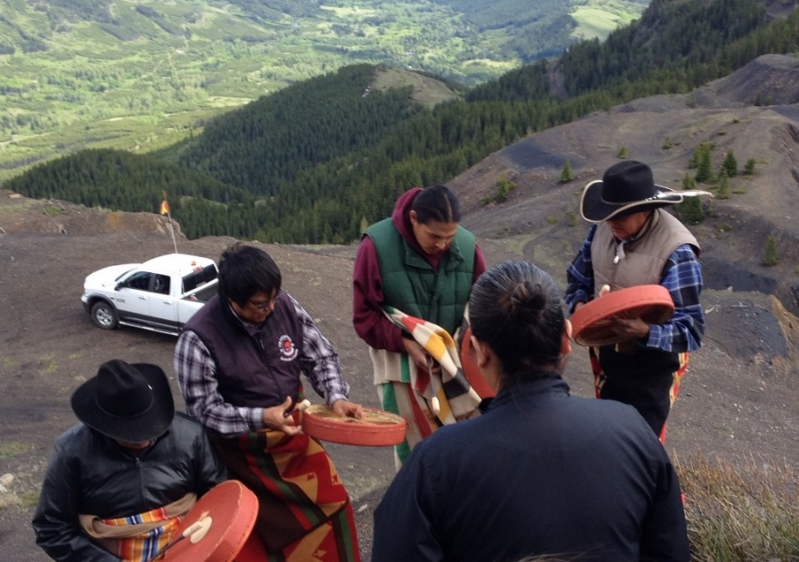
Adoption of UNDRIP - Nation states and non-government bodies
Financial and Business Organizations
United Nations Global Compact – Business Reference Guide
United Nations Guiding Principles on Business and Human Rights
International Finance Corporation Performance Standards

Slide 52
Adoption of UNDRIP - Nation states and non-government bodies
Performance Standard 7 - Indigenous Peoples (2012)
business activities minimize negative impacts, foster respect for human rights, dignity and culture of indigenous populations, and promote development benefits in culturally appropriate ways
informed consultation and participation with IPs throughout the project process is a core requirement
may include Free, Prior and Informed Consent under certain circumstances
Notes:
Many financial institutions have adopted IFC’s Performance Standards, and include them in their assessments when considering financing of major projects.
Social Risk, and in particular performance in relation to Indigenous Peoples, is typically in the top three risk factors for major projects.

Slide 53
FREE, PRIOR & INFORMED CONSENT
Assessment of FPIC in Engagement:
not unilaterally imposed or time-bound
documented and agreed to by all parties
decision process incorporates traditional decision-making, correct representative institution(s), input of vulnerable groups
build capacity within the indigenous communities
provide technical assistance - in advance of project development
encourage indigenous peoples to use external third-party advice
Notes:
Full description:
Not be unilaterally imposed
Not be time-bound
Be thoroughly documented and agreed to by all parties
Be designed with a decision-making process that incorporates traditional or customary decision-making processes, the correct representative institution(s), and the input of vulnerable groups such as women and youth
Build capacity within the indigenous communities to understand international and national frameworks and standards
Provide technical assistance to indigenous communities in language and modes of communication that ensure a complete understanding of the development phases and processes (including principles, impacts, and alternatives) in advance of project development
Encourage indigenous peoples to use external third-party advice

Slide 54
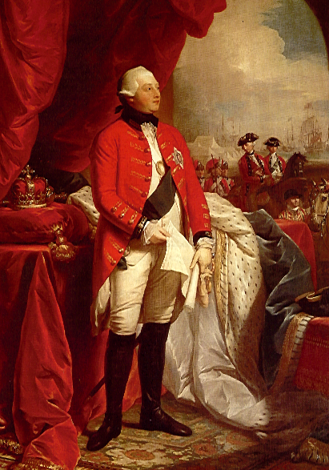
Royal Proclamation, 1763
UNDRIP/DRIPA and LRMP
“ . . .that the several Nations or Tribes of Indians with whom We are connected, and who live under our Protection, should not be molested or disturbed in the Possession of such Parts of Our Dominions and Territories as, not having been ceded to or purchased by Us, are reserved to them, . .”
-King George III

Slide 55
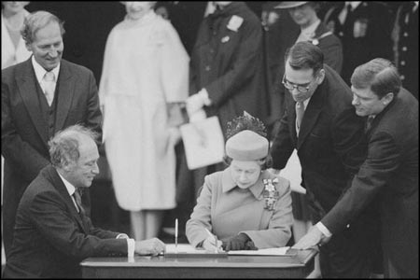
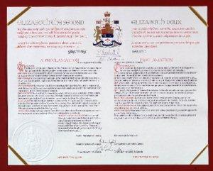
UNDRIP/DRIPA and LRMP
Constitution Act, 1982
Section 35: “the existing aboriginal and treaty rights of the aboriginal people in Canada are hereby recognized and affirmed”
Notes:
The existing aboriginal and treaty rights of the aboriginal peoples of Canada are hereby recognized and affirmed.
In this Act, "aboriginal peoples of Canada" includes the Indian, Inuit and Métis peoples of Canada.
… "treaty rights" includes rights that now exist by way of land claims agreements or may be so acquired.
… guaranteed equally to male and female persons.
The word "existing" in section 35(1) has created the need for the Supreme Court to define what aboriginal rights "exist". The Supreme Court has ruled in R. v. Sparrow that, before 1982, aboriginal rights existed by virtue of the common law. Common law could be changed by legislation. Therefore, before 1982, the federal Parliament could extinguish aboriginal rights, whereas it could no longer extinguish any rights that still existed in 1982.
Other sections of the Constitution Act, 1982 that address aboriginal rights include section 25 of the Charter and section 35.1, which sets expectations for aboriginal participation in the amendment of relevant constitutional provisions.

Slide 56
Canada: UNDRIP, Truth & Reconciliation Commission (TRC)
The Indian Residential Schools Settlement Agreement
largest class-action settlement in Canadian history
implementation began in 2007
establishment of the Truth and Reconciliation Commission of Canada
Truth & Reconciliation Commission 2008 – 2015
94 Calls to Action to redress the legacy of residential schools and advance the process of Canadian reconciliation
the calls to action were divided into two categories: "Legacy" and "Reconciliation”

Slide 57
Canada: UNDRIP, Truth & Reconciliation Commission (TRC)
Child welfare
Education
Language and Culture
Health
Justice

Slide 58
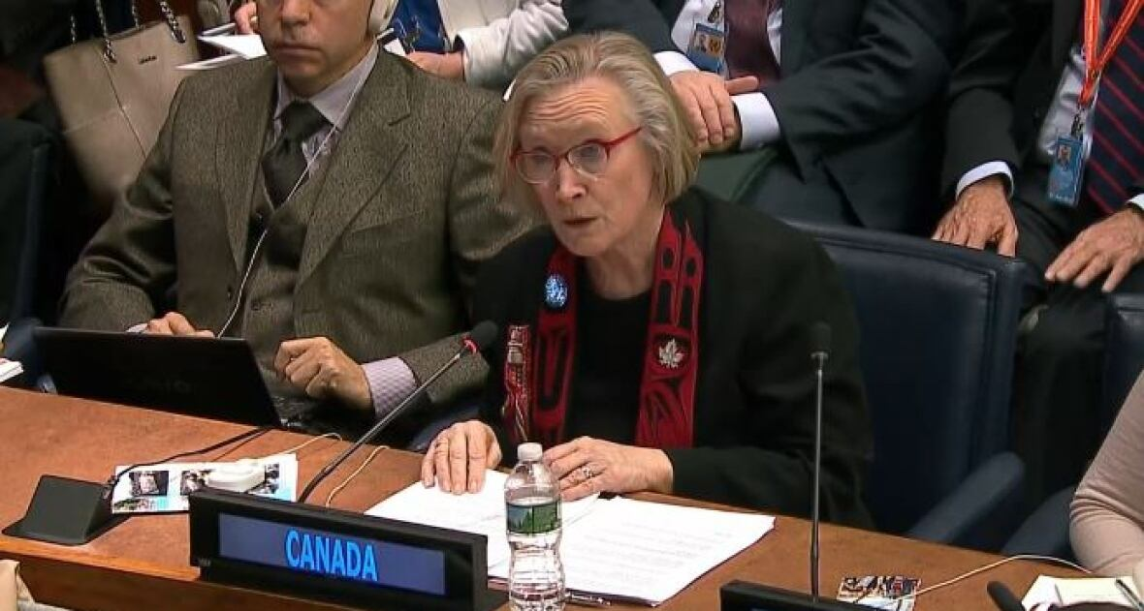
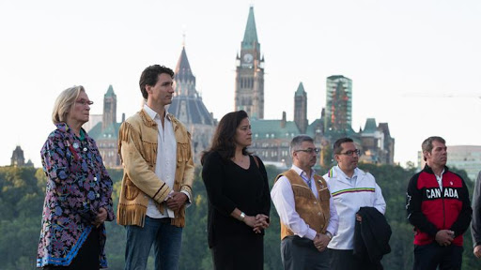
Canada: UNDRIP, Truth & Reconciliation Commission (TRC)
May 2016: Canada announced it is a full supporter, without qualification, of the Declaration.
Government of Canada

Slide 59
Canada: UNDRIP, Truth & Reconciliation Commission (TRC)
Government of Canada initiatives:
Principles respecting the Government of Canada’s Relationship with Indigenous peoples
2017, Working Group of ministers to review all relevant federal laws, policies and operational practices.

Slide 60
Canada: UNDRIP, Truth & Reconciliation Commission (TRC)
Government of Canada initiatives:
Recognition of Indigenous Rights and Self-Determination discussion tables
New Fiscal Relationship

Slide 61
UNDRIP/DRIPA and LRMP
PM Justin Trudeau - Feb 14, 2018
[T]he challenge — then and now — is that while Section 35 recognizes and affirms Aboriginal and treaty rights, those rights have not been implemented by our governments.
… And so over time, it too often fell to the courts to pick up the pieces, and fill in the gaps. More precisely, instead of outright recognizing and affirming Indigenous rights — as we promised we would — Indigenous Peoples were forced to prove, time and time again, through costly and drawn-out court challenges, that their rights existed, must be recognized and implemented.

Slide 62
UNDRIP/DRIPA and LRMP
2018 Commitment Document developed by the BC First Nations Leadership Council and BC
provides direction for joint development of policy and legislative work
references strategic planning
land use planning; decision-making approaches, models and structures; management; and intergovernmental relations … that recognize rights and title and the Declaration.

Slide 63
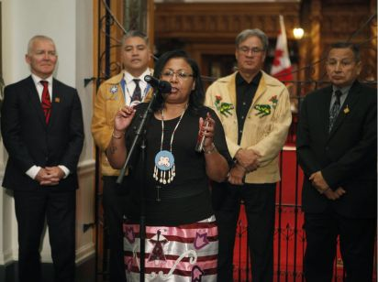
UNDRIP/DRIPA and LRMP
November 28, 2019, the Declaration on the Rights of Indigenous Peoples Act (“DRIPA”) became law.
The legislation requires:
Alignment of B.C.’s laws with the UN Declaration - as laws are modified, or built, they align with the UN Declaration
An action plan to guide implementation and includes consistent public reporting.
Notes:
Purpose of the Act:
(a) to affirm the application of the Declaration to the laws of British Columbia;
(b) to contribute to the implementation of the Declaration;
(c) to support the affirmation of, and develop relationships with, Indigenous governing bodies.

Slide 64
UNDRIP/DRIPA and LRMP
action plan to be developed with Indigenous Peoples; annual public reporting
shared decision-making with Indigenous governments, primarily through agreements
Indigenous nations or groups exercise greater self-determination and select their representation
‘collaborative consent’

Slide 65
UNDRIP/DRIPA and LRMP
shared-decision making agreements already exist between BC and First Nations
2018 Environmental Assessment Act includes collaborative decision-making
however, collaborative decision-making arrangements have been informal and difficult to implement. DRIPA provides mechanisms for processes and transparency
Notes:
2. Mechanisms within the other relevant legislation are required – therefore consequential amendments to other legislation would be required (currently only the Environmental Assessment Act enables this)

Slide 66
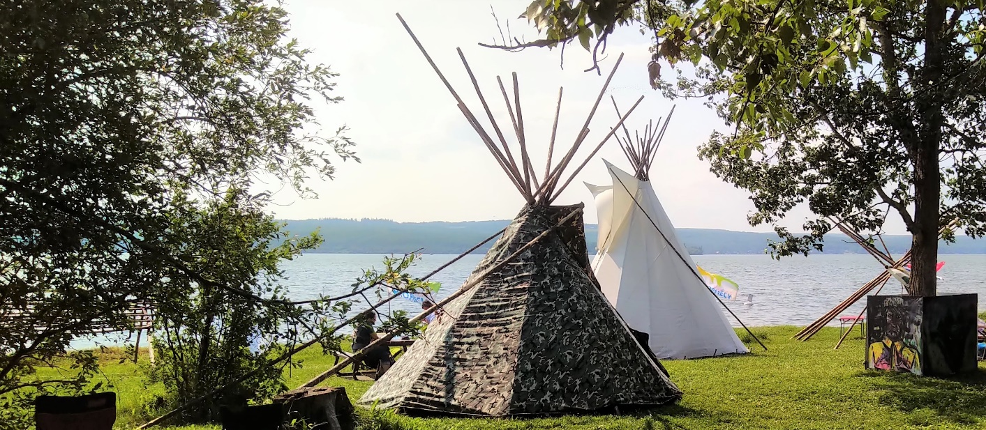
UNDRIP/DRIPA and LRMP
does not define Indigenous governing bodies as Indian bands under the Indian Act, but as self-determining groups with rights and title.
Notes:
The Declaration Act will allow the Province to enter into agreements with Indigenous governments besides Indian Act Bands, Treaty Nations and incorporated organizations (such as societies).
This means the provincial government could enter into agreements with other forms of Indigenous governments – for example multiple Nations working together as a collective, or hereditary governments – where those Nations so choose.
***An important criteria is that the Indigenous government or entity is recognized by its citizens as representing their Nation.***

Slide 67
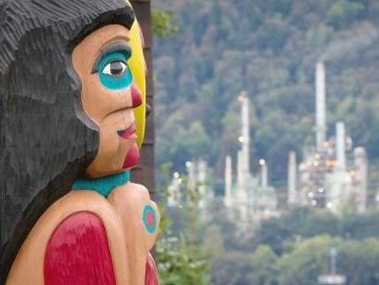
UNDRIP/DRIPA and LRMP
Consent
Consent has been a foundational part of Indigenous-Crown relations beginning with the Royal Proclamation of 1763, and also is entrenched in Constitutional section 35 law.

Slide 68
UNDRIP/DRIPA and LRMP
Consent is analogous to relations we see between governments – intended to seek agreement - as opposed to being an extension of consultation which is procedural and legal in nature. The focus in on mechanisms and processes for making decisions.
In such relations, where governments must work together, there are a range of mechanisms that are used to ensure the authority and autonomy of both governments is respected, and decisions are made in a way that is consistent and coherent, and does not often lead to regular or substantial disagreement.
- Hon. Jody Wilson-Raybould, address to the Business Council of BC April 13, 2018

Slide 69
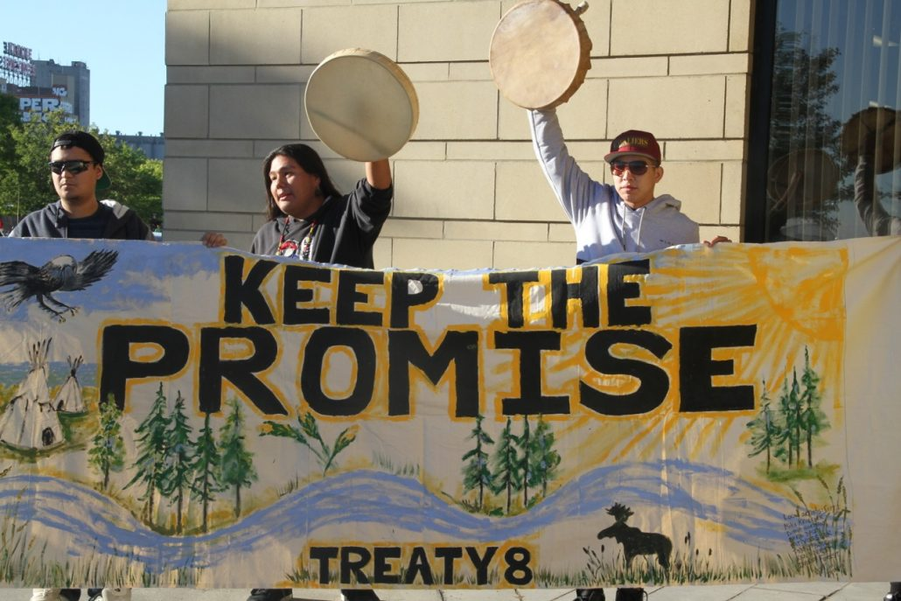
UNDRIP/DRIPA and LRMP
Consent is a factor in the new federal IA and provincial EA processes, and in some completed agreements that emphasize a shared approach to implementing UNDRIP.
The shíshálh Nation and BC have an agreement which is piloting consent-based decision-making, including land use planning.

Slide 70
FREE, PRIOR & INFORMED CONSENT
Notes:
IRPP

Slide 71
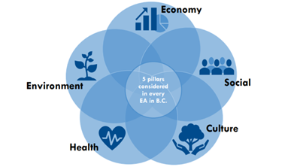
UNDRIP/DRIPA and LRMP
EAO – Revitalization
Consensus
An outcome/approach actively supported by all participating Indigenous nations and the EAO, while reserving their consent for a project after a full assessment of the project.

Slide 72
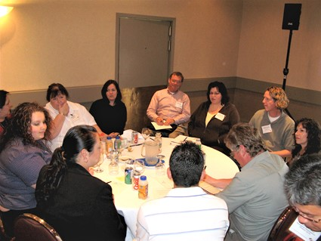
UNDRIP/DRIPA and LRMP
EAO – Revitalization
Consent
Indigenous nations can express their consent or lack of consent within the EA process at two stages.
Minister(s) are legally required to consider the consent or lack of consent of participating Indigenous nations.

Slide 73
UNDRIP/DRIPA and LRMP
EAO – Revitalization
Consent
EAO will work with participating Indigenous nations to establish a collaborative working relationship and process, that respects and seeks to align where possible, their own governance frameworks, jurisdictions and authorities.

Slide 74
UNDRIP/DRIPA and LRMP
CIGI
Implications for Land Use Planning
strengthening collaborative mechanisms between governments
creating a climate of greater predictability, effectiveness and certainty

Slide 75
UNDRIP/DRIPA and LRMP
Implications for Land Use Planning
LUP involves a process of reaching agreement about the values that must be respected re particular areas and resources and the activities that do or do not align with those values.
Reaching this type of foundational understanding that would apply to future decisions is the essence of UNDRIP and FPIC.
- IRPP Roshan Danesh and Robert McPhee, 2019

Slide 76
UNDRIP/DRIPA and LRMP
Benefits of using a consent-based approach to land use planning
Avoids the ‘one size fits all’ land use planning models
Emphasis on self-determination provides for a more flexible approach to considering the governance model to guide and direct land-use planning

Slide 77
UNDRIP/DRIPA and LRMP
Implications for Land Use Planning
Co-design or co-development of policies and legislation that relate to or impact Indigenous people
Can be operationalized in several ways, including the process, structures, decision-making process, end products

Slide 78
Dialogue and Next Steps

